Slide 1

GANimation: Anatomically-aware Facial Animation from a Single Image
Albert Pumarola, Antonio Agudo, Aleix M. Martinez, Alberto Sanfeliu, Francesc Moreno-Noguer.
Presented by: Eric Cañas Tarrasón
Notes:
My Name is Eric Cañas and I will present GANimation. This work propose a GAN Network which focuses on generate facial expression animations from a Single Image. It was awarded with the Best Paper Award Honorable Mention at ECCV 2018.

Slide 2
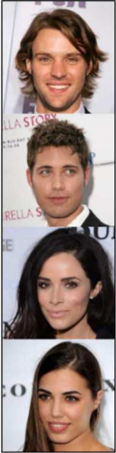
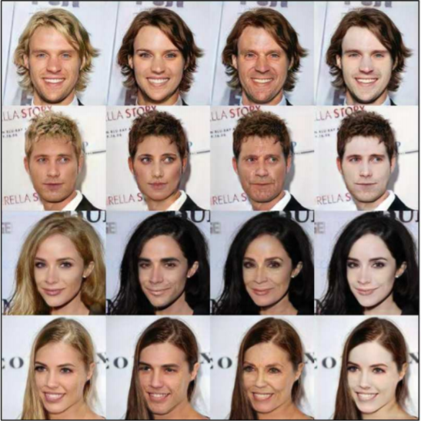
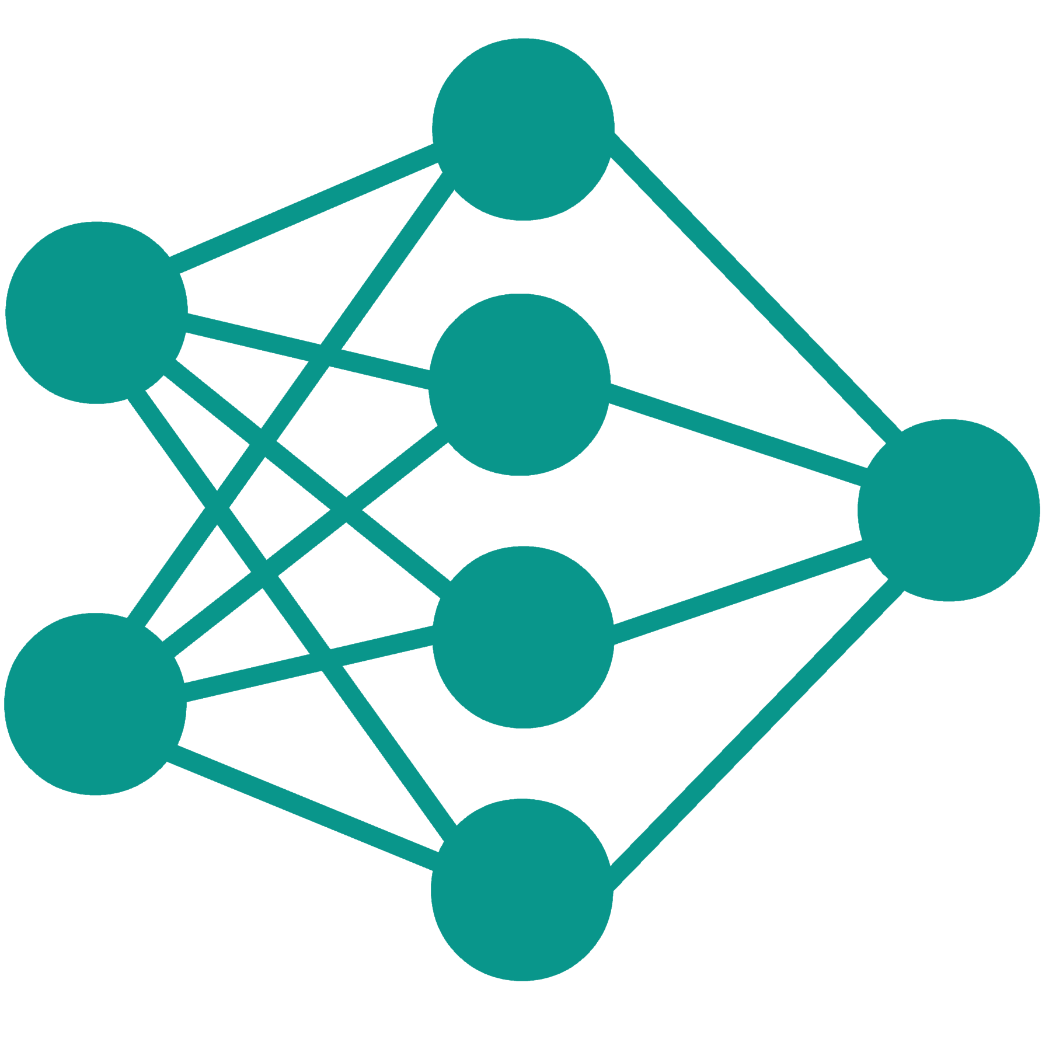
Image to Image Translation Problem
Input
Blond Hair
Gender
Aged
Pale Skin
Modify Individual Attributes from Faces
Maintaining the Face Identity
*StarGAN Results [1]
Notes:
GANimation focus it works over a very concrete field of the Image to Image translation problem. Works in this field aims to modify individual attributes from Face Images while maintaining the identity of that face. For example, generating from these kind of Inputs, outputs where an attribute such as Hair Color or Gender is changed.

Slide 3
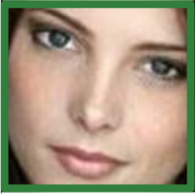
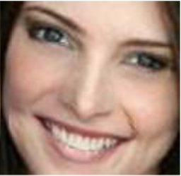
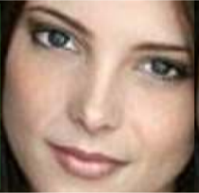
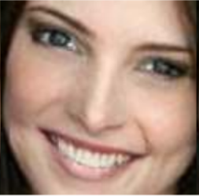
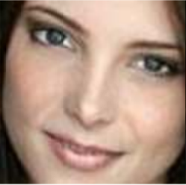
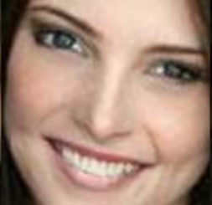
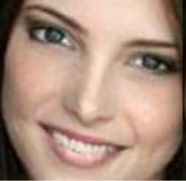
Rendering Novel Expressions in a Continuum
Input
Smiling
Discrete Output
Smiling .12
Smiling .87
Smiling .25
Smiling .75
Smiling .50
Notes:
More Concretely, GANimation focuses in rendering novel expressions from an Input Image. There are already several works through the state of the Art which taking an input image are able to generate a requested novel expression. But the proposal of this work is to remove this inherent discretization, generating these novel expressions in a continuum space.

Slide 4
Methodology
Conditional Learning Based on Action Units
Fully Unsupervised Strategy
Notes:
To achieve this goal, the most relevant Key Point which this work introduce is its methodology. It present a conditional learning Scheme based on the Facial Action Units, and training in a Fully Unsupervised way.

Slide 5
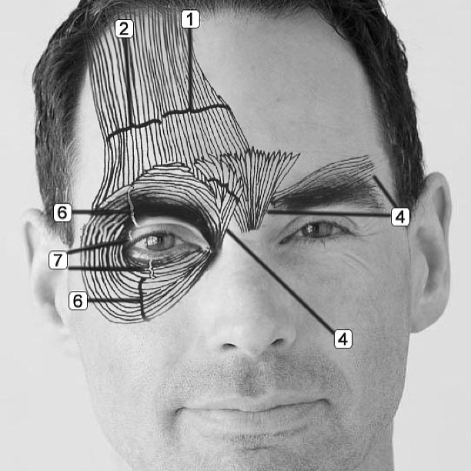
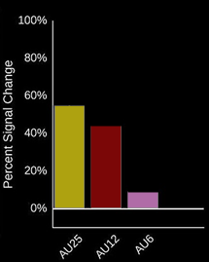
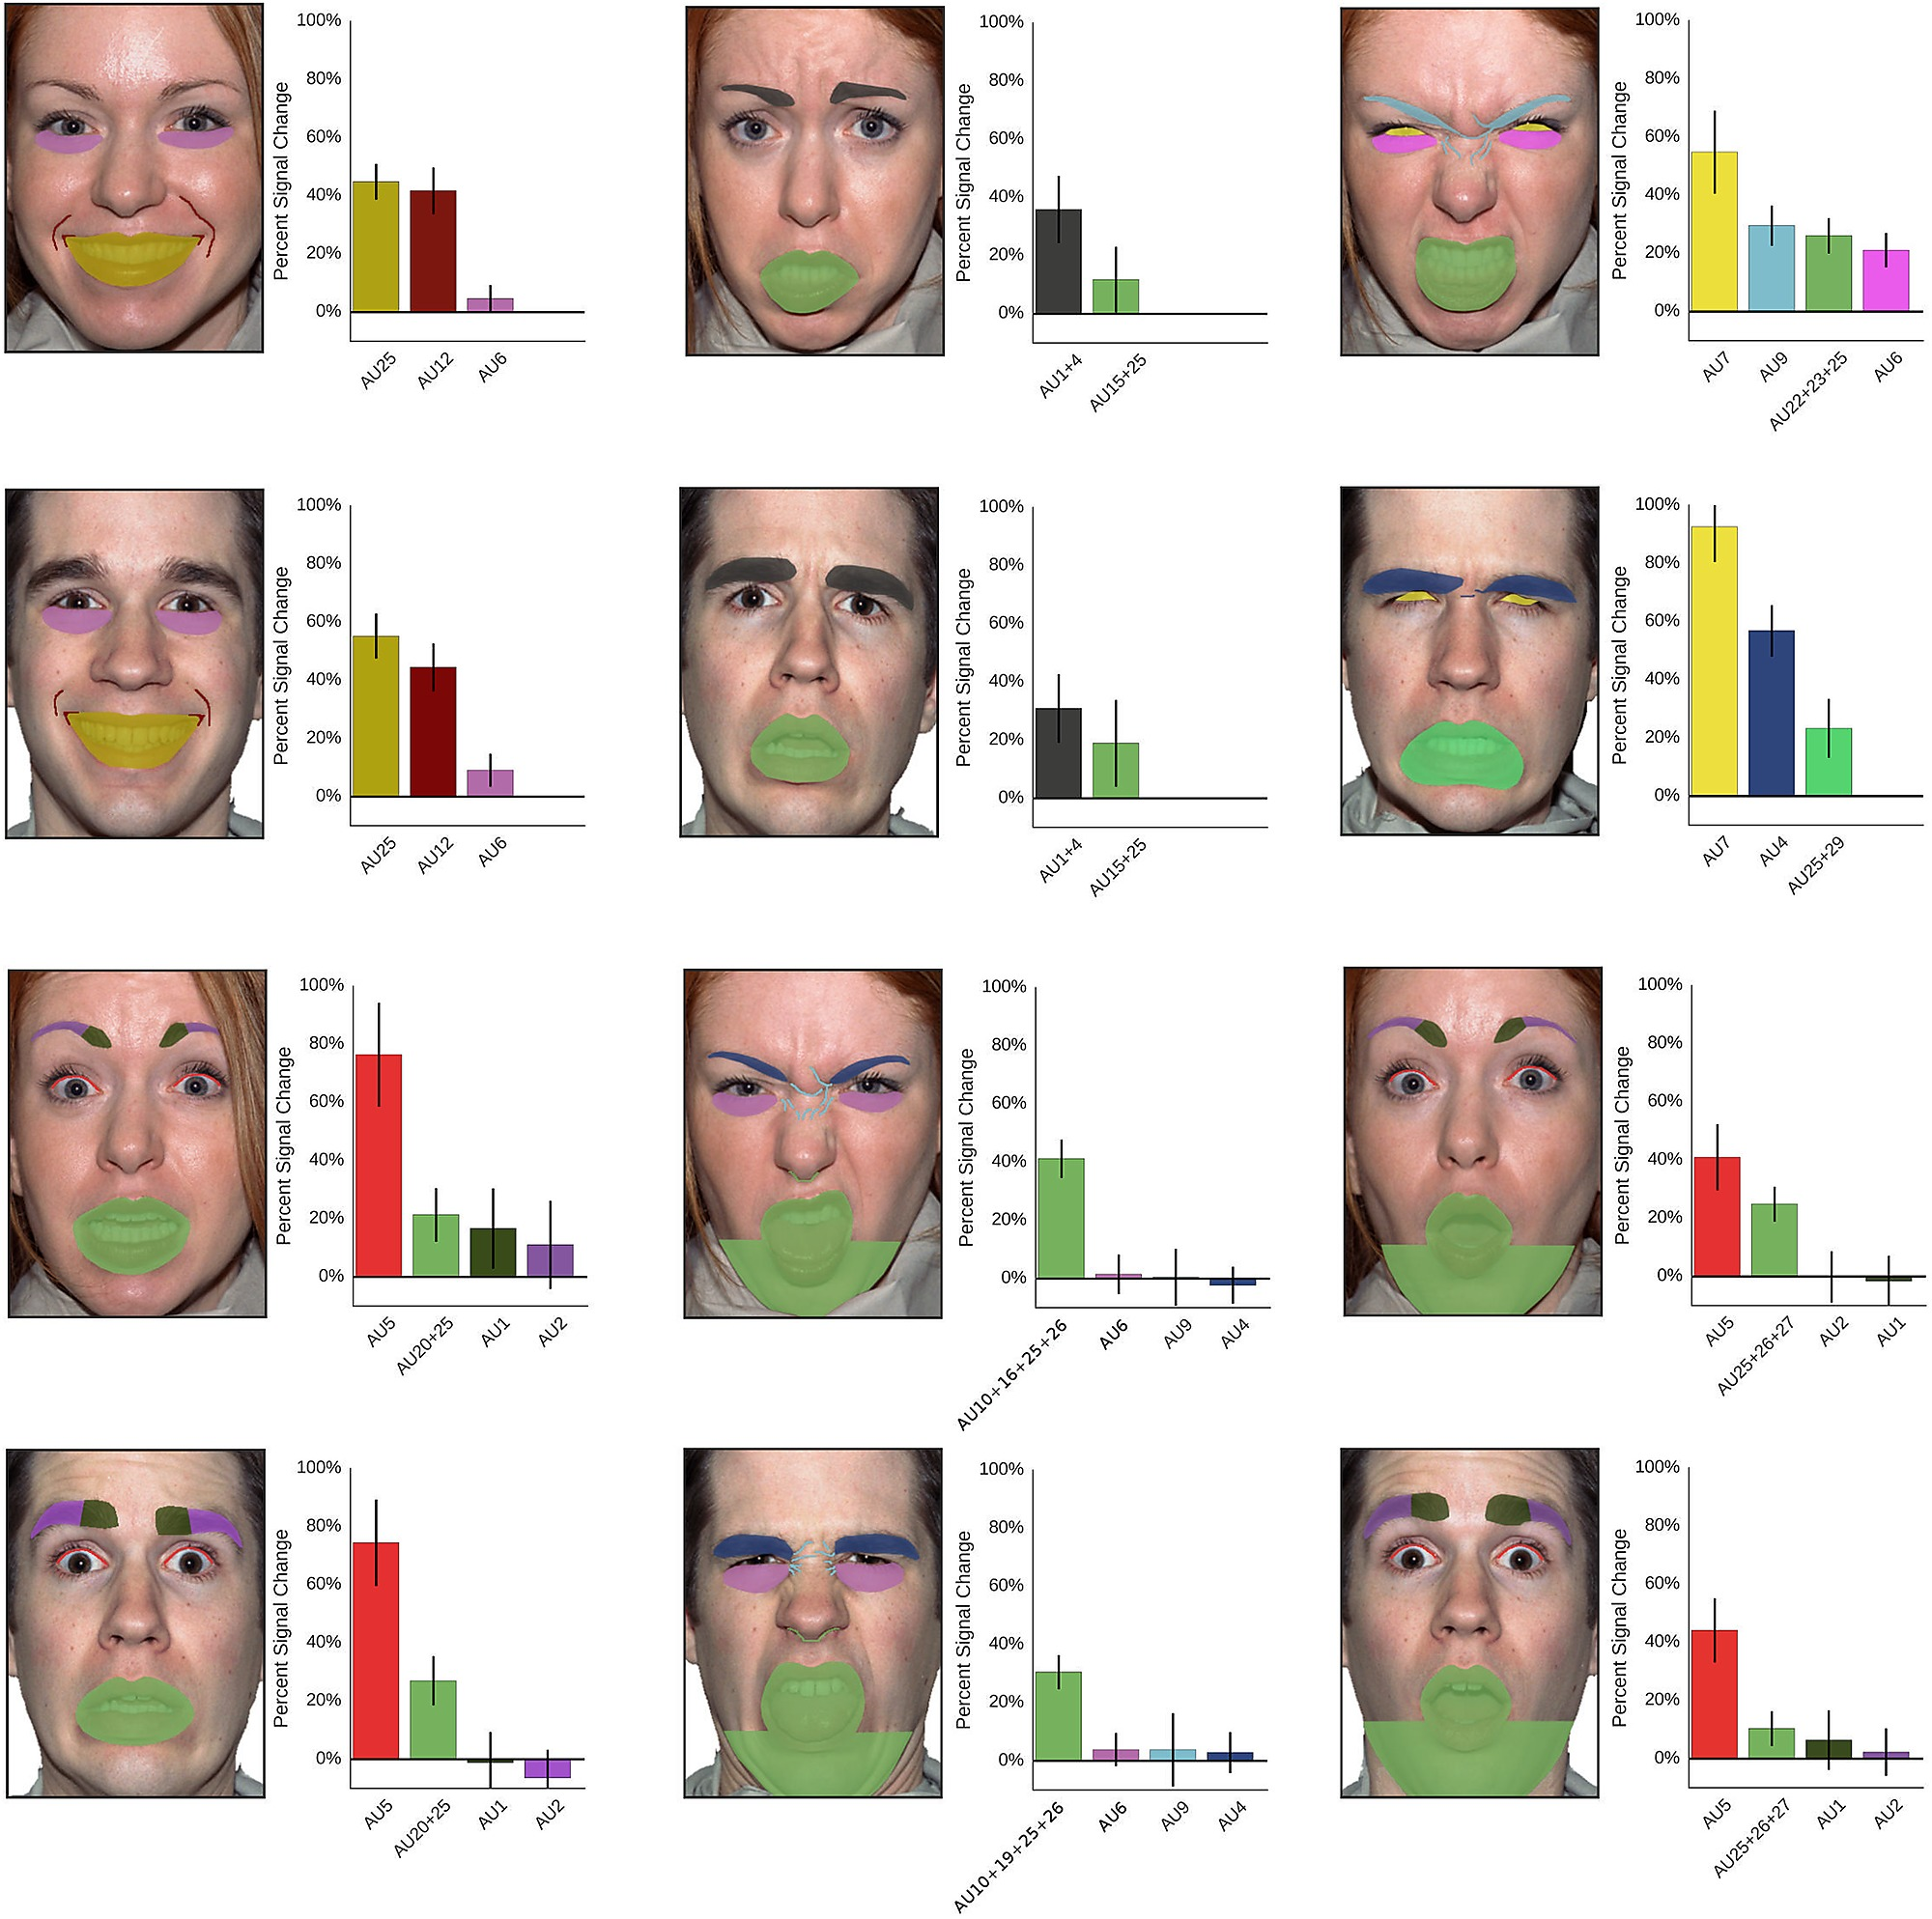

Conditioning Scheme Based on Action Units
Action Units
Facial Action Coding System
(FACS)
$Y_{r}$ Conditioning Parameters
*Auto Annotation Systems [3]
*Facial Action Coding System [2]
Notes:
So what Action Units are? Action Units are the fundamental individual actions done by certain groups of face muscles. They are defined by experts and codified through the Facial Action Coding System. And they can be automatically analyzed, generating an auto-annotated dataset, containing for each photo a vector with each Action Unit Activation. These annotations can be used as the Conditioning Parameters of the network.

Slide 6
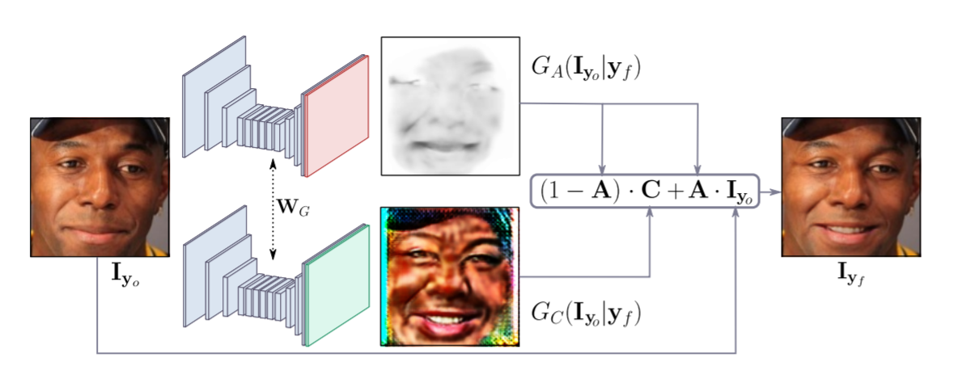
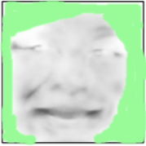
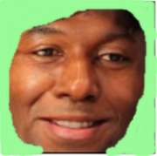
Generative Model Basic Scheme
Notes:
Now, The Key Point which makes the system work as well as it works is the Generative Model which it proposes. This model is not centered into generate a final image as most of the usual Generative Models. Instead, it generates 2 masks. An attention mask which weight the importance of each pixel variation, and a color mask which will define the new image changes. Final image will be obtained from mixing the Input and the Color mask as the attention mask indicate. This method allows the network to keep backgrounds and static elements unchanged between images, focusing the learning efforts only in the changing structures.

Slide 7
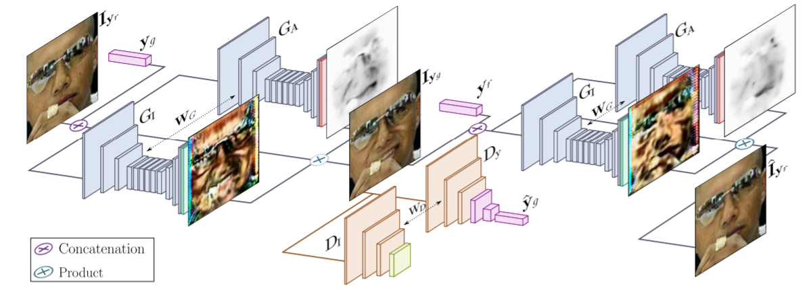

Cycle Consistency Non Supervised Scheme
Inputs
Output FACS (Smile)
Original FACS (Serious)
Outputs
Output FACS
(Smile)
Recover of $Y_{g}$ and $I_{y_{r}}$ as optimization metric
Notes:
In order to make this learning process unsupervised the last presented network is followed by an inverse network, which will try to recover the original Input. Then the pipeline is defined as follows: An input image is introduced with wanted Action Unit activations (defining the new expression). Then, applying to this output image, the activations of the original Action Units, the original Input should be recovered, including image and that first Objective Expression.

Slide 8
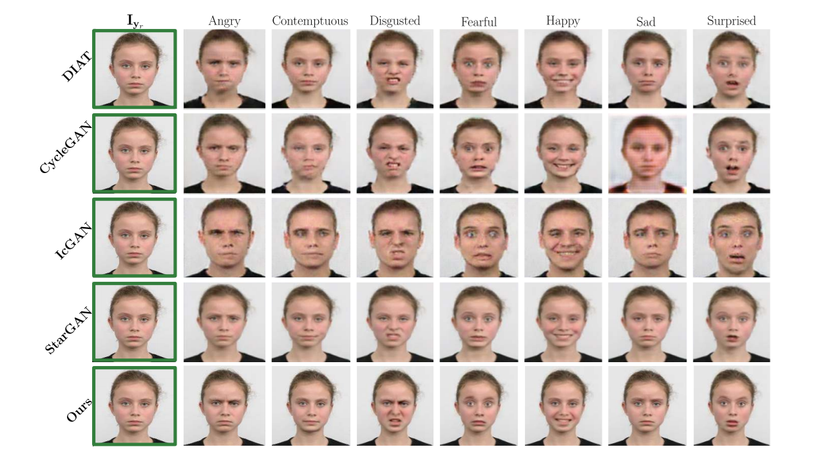
Results
Improving the State of the Art Over Discrete Emotions
SoA
Better Quality
Notes:
Using the learning method presented in last slides, GANimation has been able to achieve the current State of the Art results, improving it with photo-realistic images with a better quality.

Slide 9
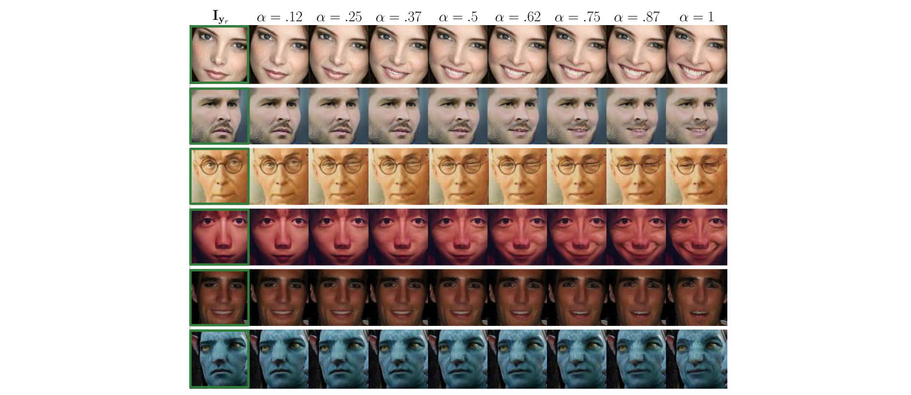
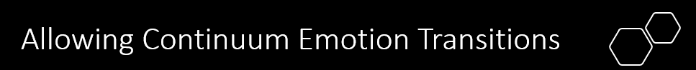
Allowing Continuum Emotion Transitions
Notes:
However, the key point of the GANimation achievement has not been in this discrete emotion field. Since the approach has lead with a higher level problem, generating results in a non discrete space.

Slide 10
Discussion
Notes:
So, now, with this knowledge in mind, it is important to make a more accurate analysis about the strong and weak points that the work presents.

Slide 11
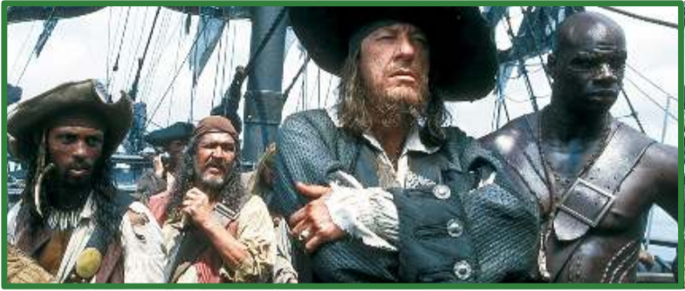
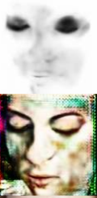
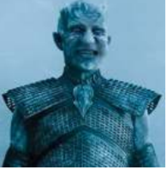
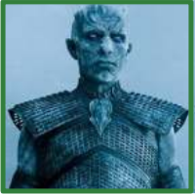
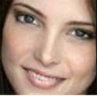
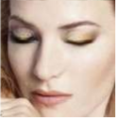
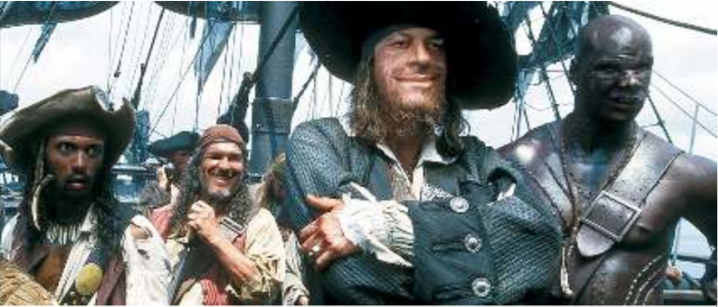


Key Strong Points of the Method
A
What are the Backgrounds
Mask Based Prediction System
Continuum Prediction System
Not How are the Backgrounds
Smiling 0.5
$$I_{y_{g}}$$
$I_{y_{g}}$ = (1 − A) · C + A · $I_{y_{r}}$
Images on the Wild
Half Expressions
Animations
Robust to Non seen Colormaps and Iluminations
C
Notes:
One of the strongest keypoints of this method lies in the way how images are predicted. Since the system obtains it outputs images through two generated masks applied over the input image, it allows the model to recognize what are the backgrounds, but without focusing on how these backgrounds are. It absolves the network of the charge of generating them. Moreover, it allows the network to be so robust to non seen color and illumination changes. These two aspects makes the network ideal for be applied over Images on the wild, such as film scenes. The second strongest point is one of the novelties that the approach introduces: The generation of expressions in a continuum space, allowing parameterizable half emotion expressions and even complete animations.

Slide 12
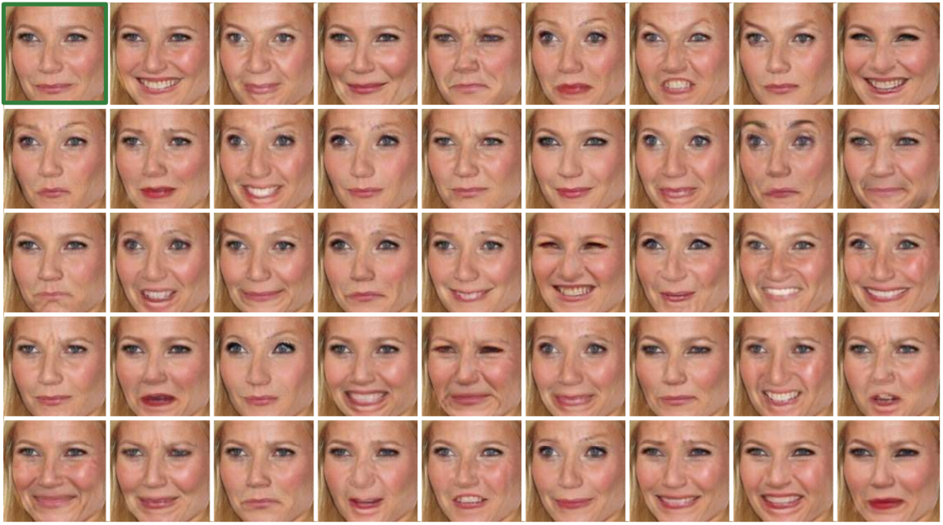
More Strong Points of the Method
Mixable Action Units Activations
Non-Supervised Training
Modifying Cats? Cars?
Enormous Combinatory of New Expression Mixes
Could be Applicable over any Element with Auto-Predictable FACS Equivalent
Notes:
In addition, there is important to denote that this paradigm transition from discrete individually learned emotions to a continuum system based on Action Units, makes these Action Unit mixables, generating an enormous combinatory of new non trained facial expressions. Finally, the proposal about auto-annotated non supervised training, opens the door to any equivalent problem where similar aspects could be annotated in the same way. Maybe Cat Expressions? Or even modify Car images? For example, reinterpreting Action Units as attributes such as how much deflated is a Wheel or how much a door is opened.

Slide 13
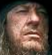
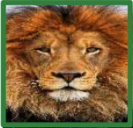
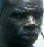
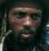
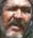
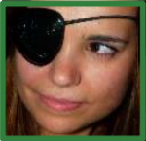
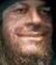
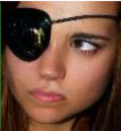
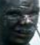
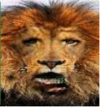
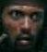
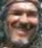
Key Weak Points of the Method
Only Running Over Cropped Face Images
Non Trained Occlusions Produce Artifacts
Additional Step in the Pipeline which Could Fail
Always Deform to Human Traits
Depends on a Face Detector
Non Generalist Content Aware method
Notes:
But, In Spite of all the Strong points of the method there are some drawbacks which could be taken into account.
The algorithm only runs over Cropped Face images. So, really when dealing with images in the wild such as previously presented, a previous crop has been applied before the transformation. It adds up an additional step which could fail.
Moreover, algorithm tends to produce artifacts when non seen elements produces face occlusions.
And Finally, It is a content aware method, trained with the anatomy of human faces, so if it is applied to different images, results would be always deformed, generating human traits on images where it is not expected.

Slide 14
Why it works
Model Focus Attention Only Over Relevant Features for Expressions
It allows to learn only what is necessary
No background, no immutable features (glasses)
Non Supervised Method Eases an Adapted Dataset Generation
Notes:
Then, summarizing the main aspects why the algorithm works so well: Besides the Action Units explained system, the quality of the method lies in how the model focus it attention. The mask system allows each part of the network to focus only in which is relevant to change, since the rest will come directly from the input image (No Backgrounds, no immutable features).
Additionally the dataset is auto-annotated, and it allows to easily generate large datasets with rich information for the problem.

Slide 15
Future Work
Animating with Poses
Application Over non Human-Face Datasets
Modifying Emotion Over Video Cuts
Notes:
And for conclude, it is interesting to make a brief comment about how this work could be continued. As his author proposes, it could be interesting to research about its application over video scenes and even animating with human poses. However, in my opinion, the most important fields where this work could lead , would be to its application over other equivalent auto-annotated datasets different from human faces. Reinterpreting the Action Unit system for Animal expressions, or even modifying inanimate objects such as cars. This paper proposes a smart and precise method for solving some aspects of the Image to Image Translation Problem, and it would be an error to non exploit it outside the field of Face Expression Modification.

Slide 16
References
Paul Ekman Group. FACS Manual.
Martin Wegrzyn, Maria Vogt, Berna Kireclioglu, Julia Schneider & Johanna Kissler.: Role of specific action units for emotion recognition. Available at: https://journals.plos.org/plosone/article?id=10.1371/journal.pone.0177239
Yunjey Choi, Minje Choi, Munyoung Kim, Jung-Woo Ha, Sunghun Kim & Jaegul Choo.: StarGAN: Unified Generative Adversarial Networks for Multi-Domain Image-to-Image Translation. At CVPR2018. Available at: https://arxiv.org/pdf/1711.09020.pdf
Notes:
Thanks for your attention

